Slide 1
Glue Code And Step Implementations

Slide 2
What Is Glue Code?
While Gherkin is understandable for everyone on a development team, features files are not compatible with the programming languages in which applications are written.
If, for instance, a developer is writing an application in Java, the compiler can't make sense of Gherkin.
Because of this incompatibility, Cucumber allows developers to "translate" Gherkin into source code;
Cucumber simply generates the appropriate source code based on the BDD keywords used within the feature file.
The source code that Cucumber generates is called glue code.
Glue code is simply executable code that takes some source material that is incompatible with the system and adapts it.
Note that this term is not specific to Cucumber.
Many tools generate glue code for developers as a matter of convenience.

Slide 3
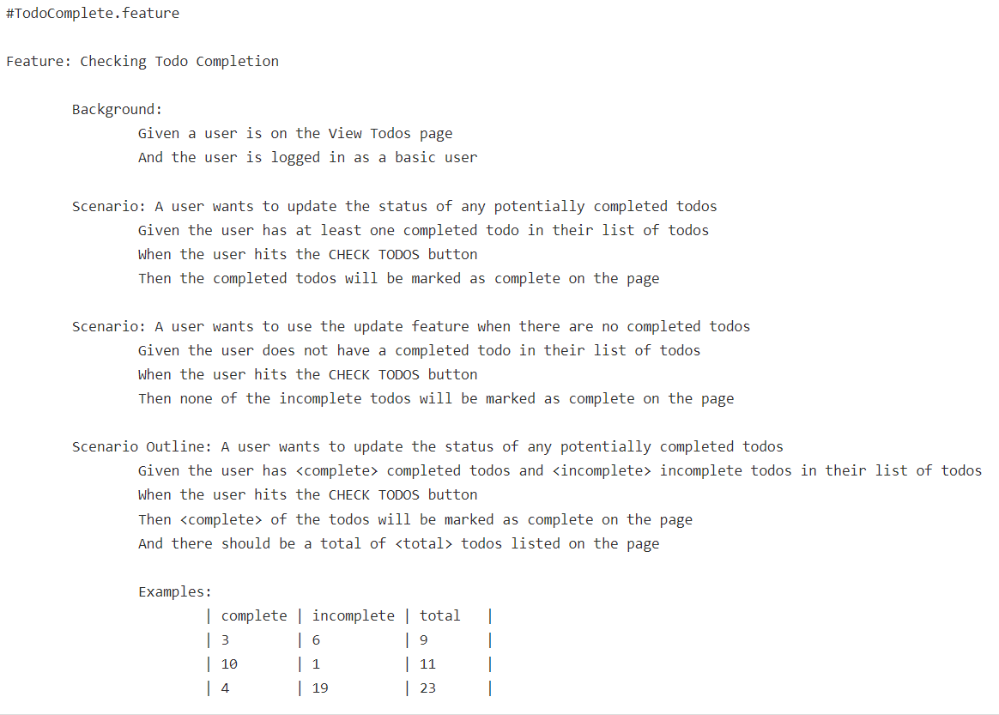
What Are Step Implementations

Slide 4
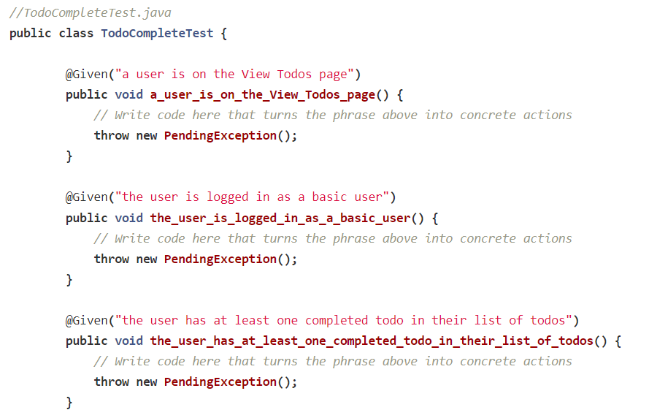
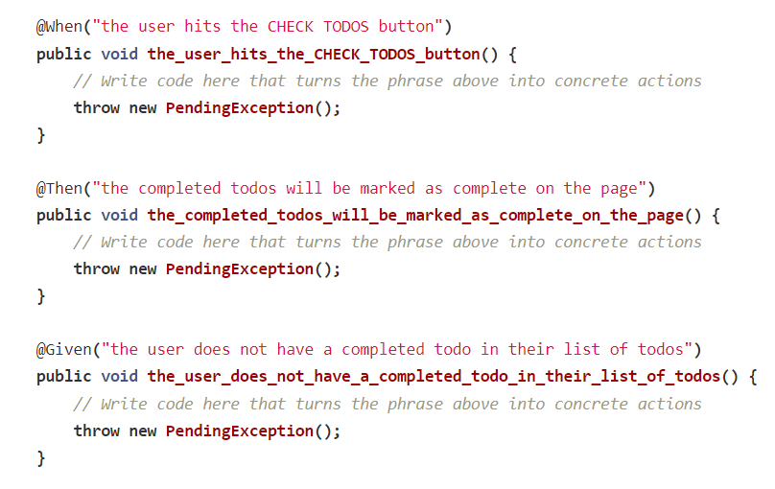
What Are Step Implementations
There is lot more code involved

Slide 5
What Are Step Implementations
The file shown above is known as a step definition file.
It is referred to as such because it contains methods which are associated with steps from a feature file.
Let's note a few more things about the file above:
Each method contained within this file is annotated. As you can see, these annotations are BDD keywords and provide metadata which describes what each method should test at a high level. If we turn this class into a test suite using a testing framework, we'll then be able to run each step as a test.
The methods are not implemented be default as the developer is logically tasked with writing the step implementations. A step implementation is the implementation of a method that is identified as a step by one of Cucumber's annotations.
The methods which are associated with scenario outlines have parameterized metadata. These parameters will allow for running the tests we'll create later with multiple data sets.

Slide 6
Cucumber Integration With JUnit

Slide 7
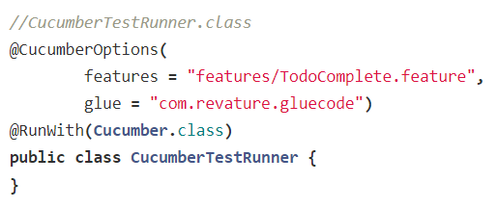
Running Glue Code Using a JUnit Test Runner
We need to do a couple of more things to get a suite up and running. We'll start by creating a configuration class which specifies options for how we would like to run our glue code

Slide 8
Running Glue Code Using a JUnit Test Runner
The CucumberTestRunner class itself is completely empty.
We have only created the class so that we can provide metadata about which Cucumber features we want to incorporate in our tests.
We've used the @CucumberOptions annotation to specify metadata about the features and glue code we're working in this example.
The features attribute specifies the location of the feature file(s) we're using. We've placed our files inside of a directory called features.
The glue attribute specifies the package in which you can find step definitions and implementations.
We have placed ours in a package called com.revature.gluecode.
We've also used the @RunWith annotation.
This annotation should be familiar to you if you've used JUnit before.
Using this annotation, we've specified which test runner we want to use.
We are using a special test runner made just for running glue code generated by Cucumber.

Slide 9
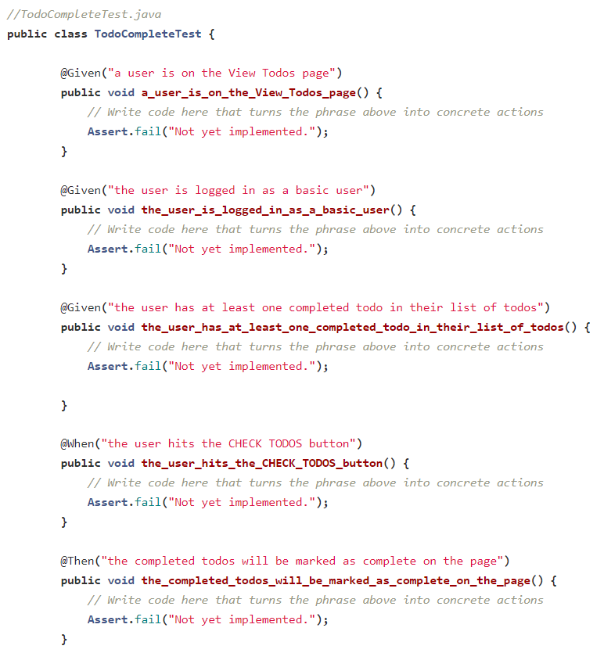
Running Glue Code Using a JUnit Test Runner
Now that we've configured our test runner, let's make a few small modifications to our glue code

